Slide 1
Covid19 - Sequence and State Diagrams
Group 6
Yibo Fu
Yezi He
Ran Zhang
Han Wang

Slide 2
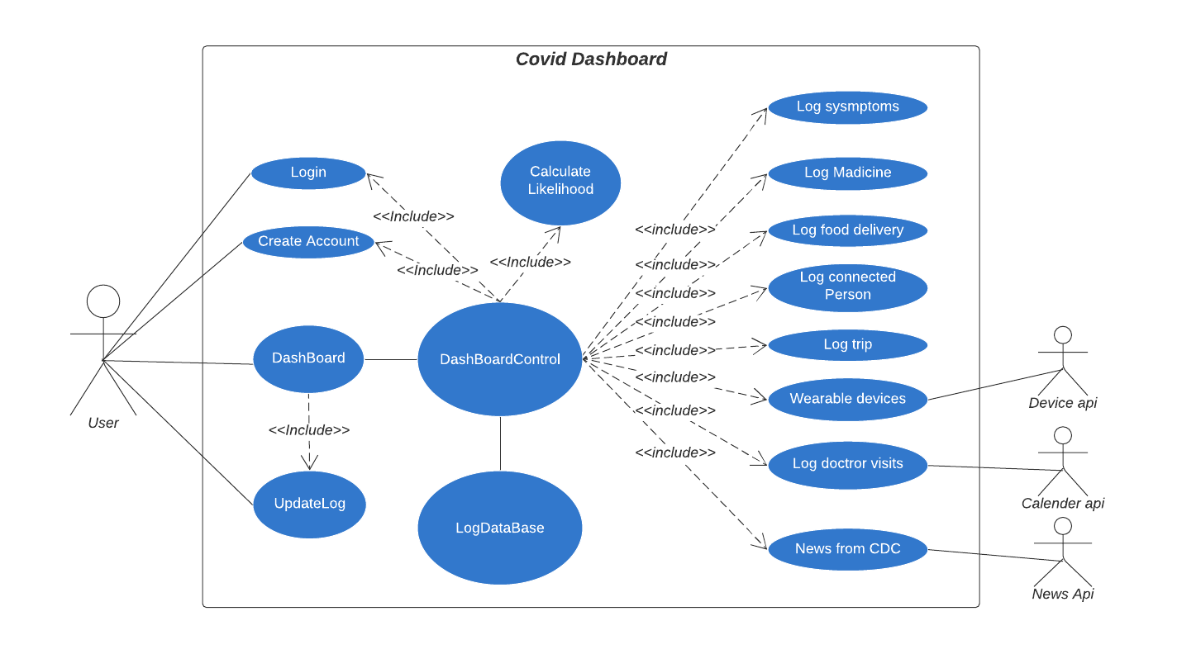
Use Case Diagram:

Slide 3
Actors:
User(Client)
Wearable Device API
Calendar API
CDC News API

Slide 4
Use Cases: Login page
Create account
Users login
Forget password option

Slide 5
Use Case: Dashboard1 Manual logs
Create logs:
Doctor visits report
Trips details, including transportations logs, hotel stays logs, etc.
Medicines that current taken.
Contacted persons. Including dates, relations, contact period.
Food Delivery.
Symptom logs.
Manage logs:
Delete certain logs.
Edit logs.
Search logs.

Slide 6
User Case: Dashboard2 Auto generated/import logs
Wearable devices:
Health data logs: steps per day, heart beats alert, blood oxygen level monitors.
Daliy CDC news and covid 19 updates
User calendar access:
Doctor appointments
Trip tickets
Public activities

Slide 7
Use Case: Expose Alert
Based on logs recorded from user, send alert(notification) to user automatically.
Contacted person record.
Restranuat expose based on news.
Symptoms recorded.

Slide 8
Administrator
Log in/Log out
Update news for users from CDC, etc.
Data summary:
User statistics
Daily usage

Slide 9
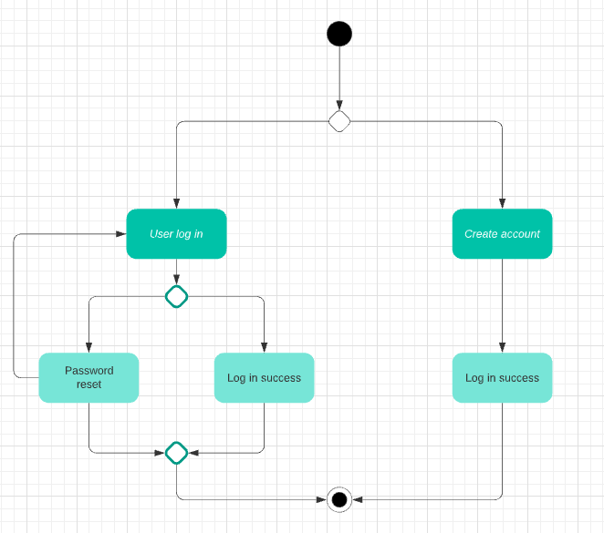
Login page
Use Case Description:
A user login to the system to access all functions.
Actors: User
Steps:
Sign in or Sign up
Enter username and password
Forgot password option
Login success if id and password match

Slide 10
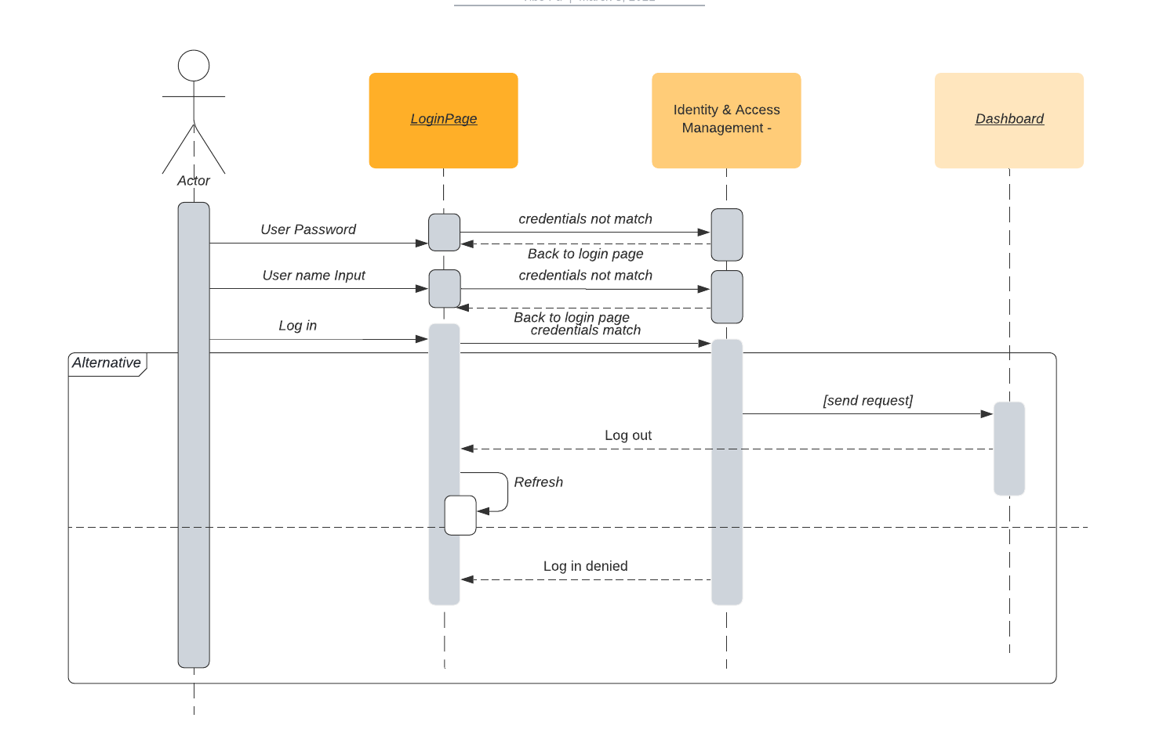
Sequence Diagram:
Log in

Slide 11
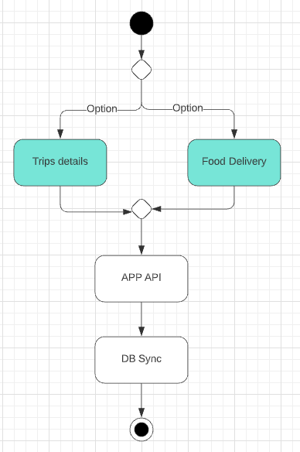
Use Case: Auto Sync App
Access user’s calendar app for schedule updates.
Access user’s food delivery schedule.
Other relative APP can be tracked via its API

Slide 12
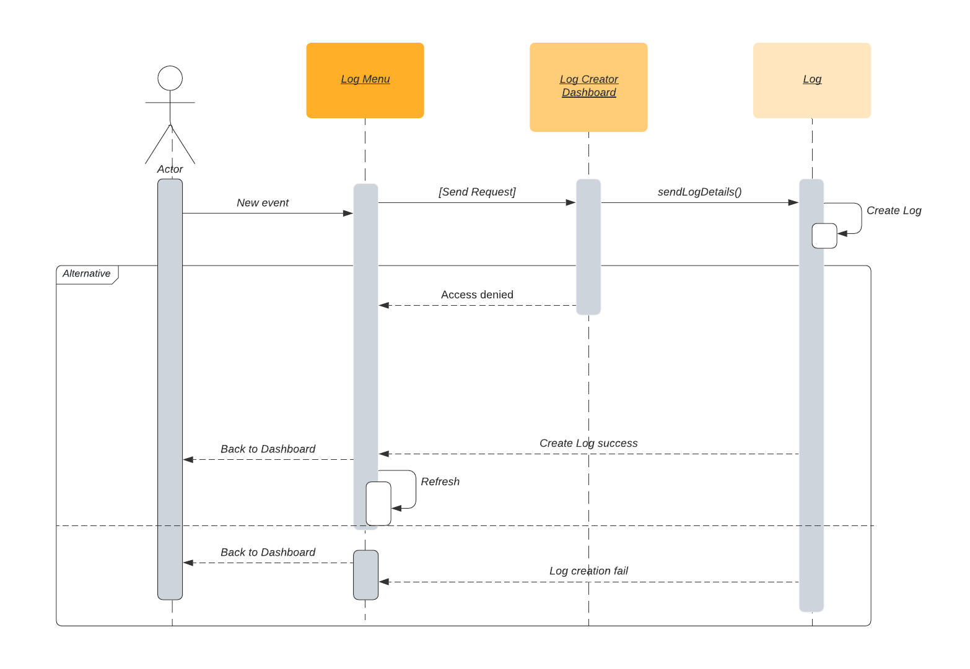
Sequence Diagram:
Auto Sync

Slide 13
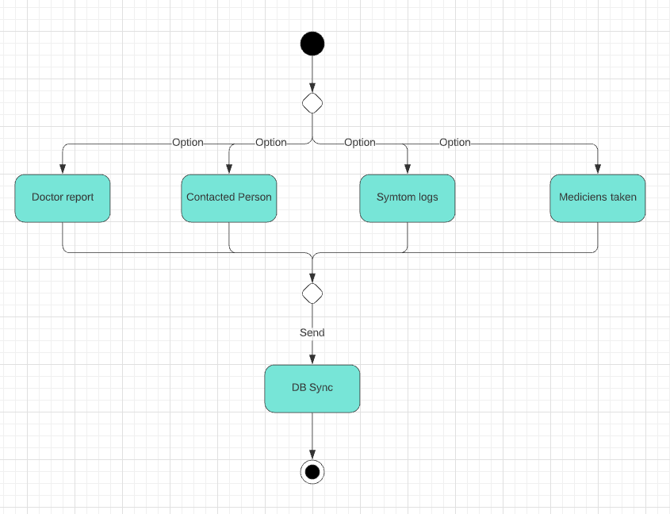
Use Case: Manual input logs
Manually created logs:
Doctor visit reports
Medicines currently taken
Contacted persons
Symptom logs
Manage logs:
Delete certain logs.
Edit logs.
Search logs.

Slide 14
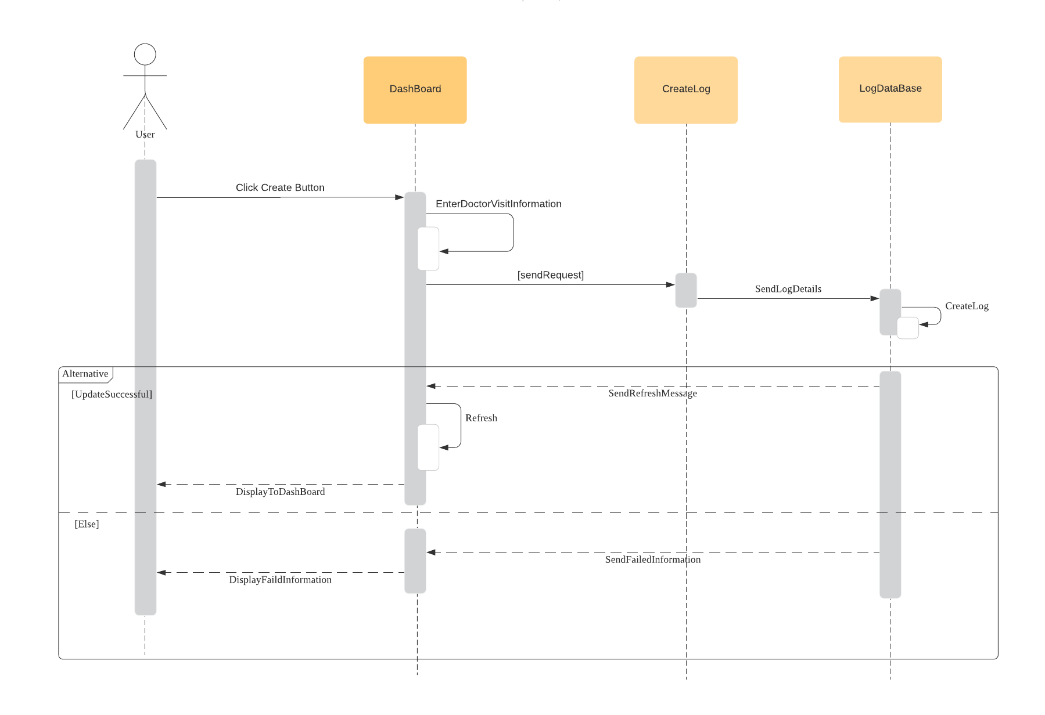
Sequence Diagram:
Doctor Visit

Slide 15
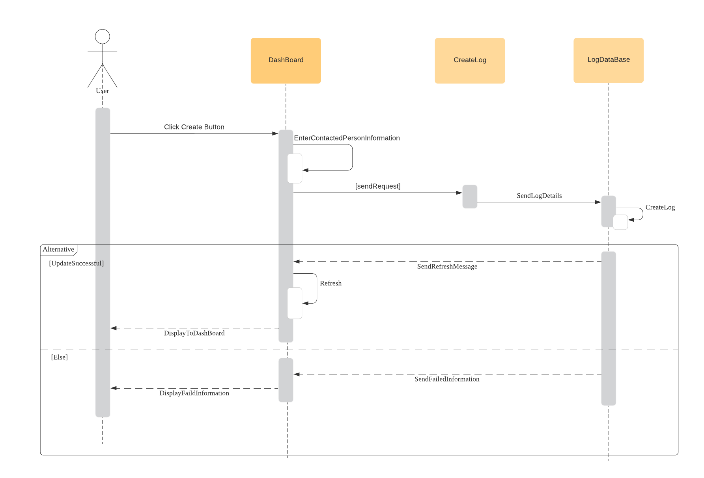
Sequence Diagram:
Contact Person

Slide 16
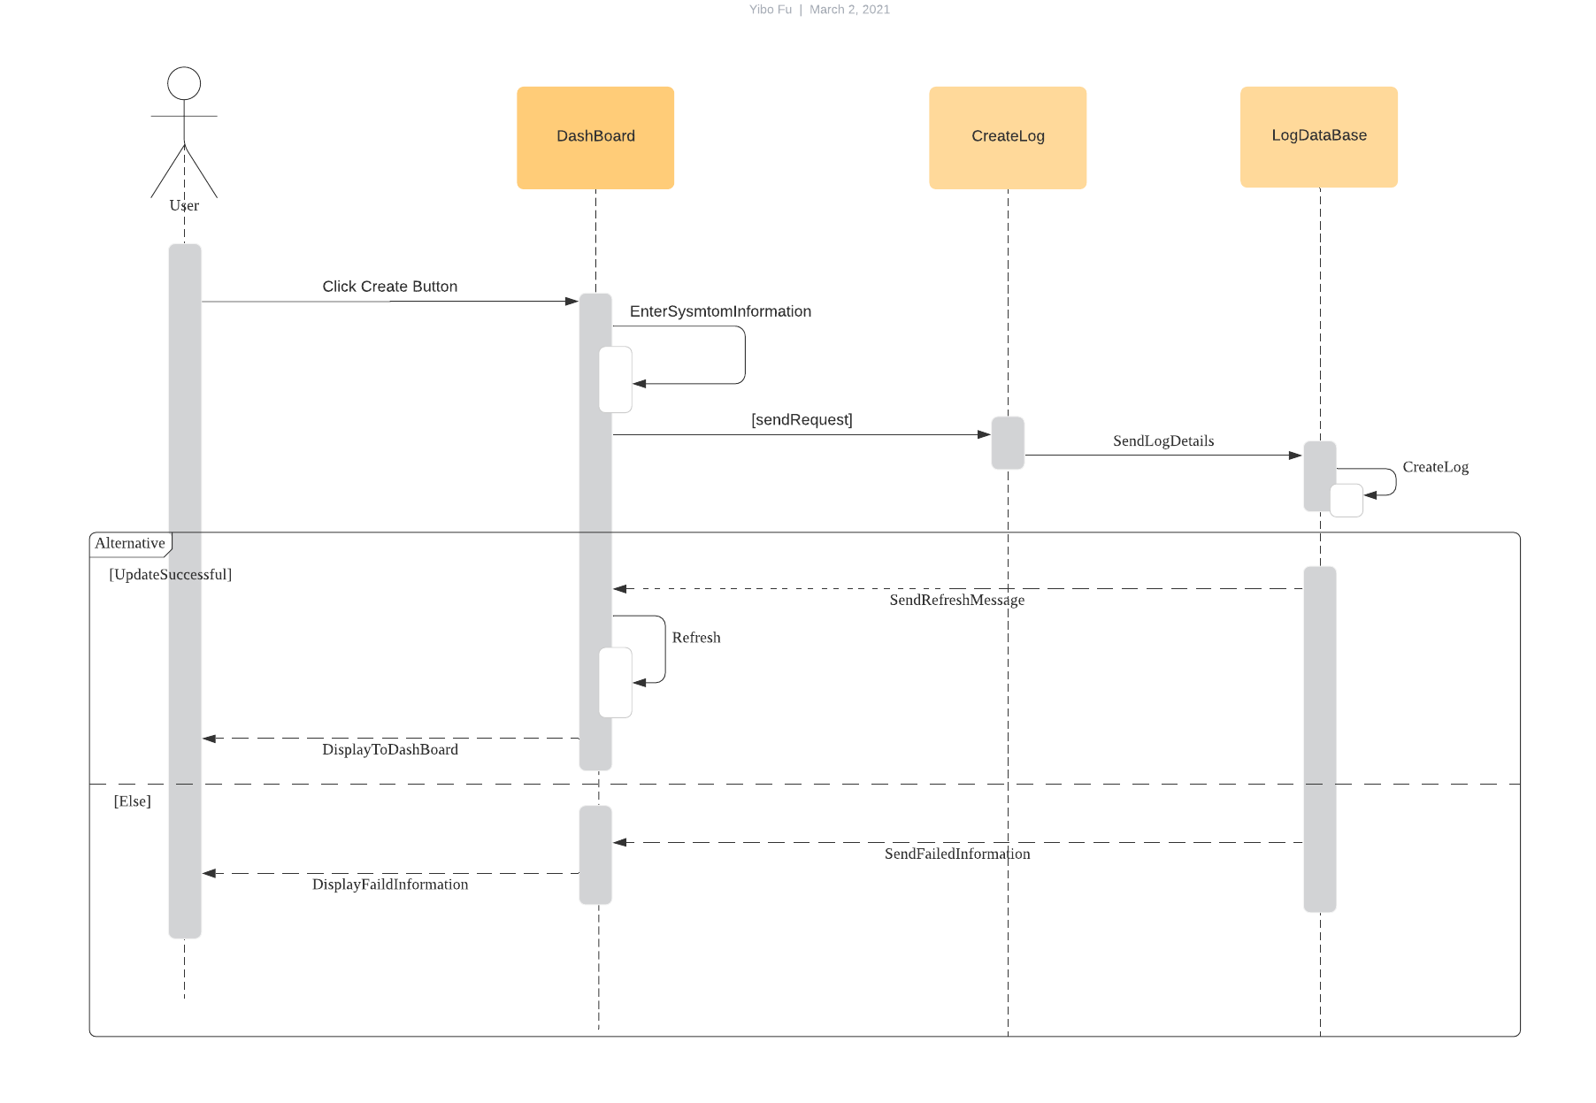
Sequence Diagram:
Symptom

Slide 17
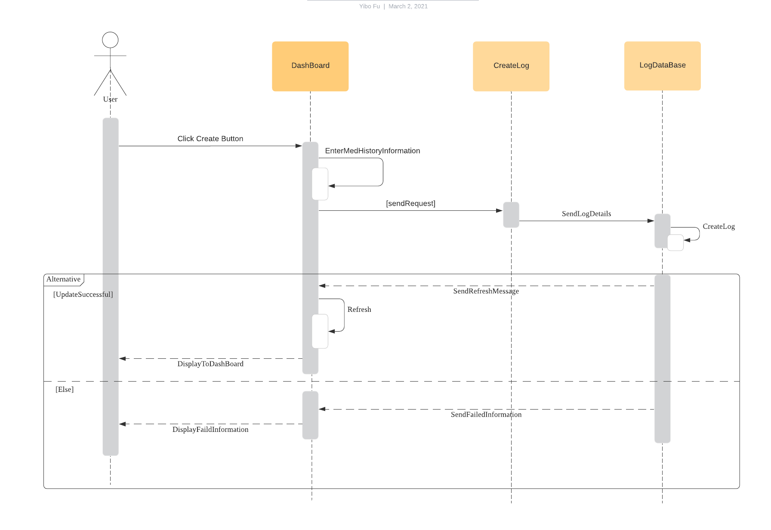
Sequence Diagram:
Med History

Slide 18
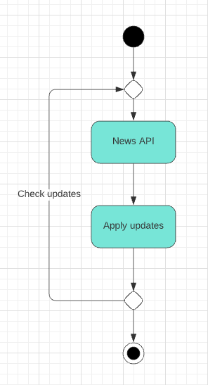
Use Case: Daily CDC news
Sync daily news API to target position
Check updates every time when page refresh

Slide 19
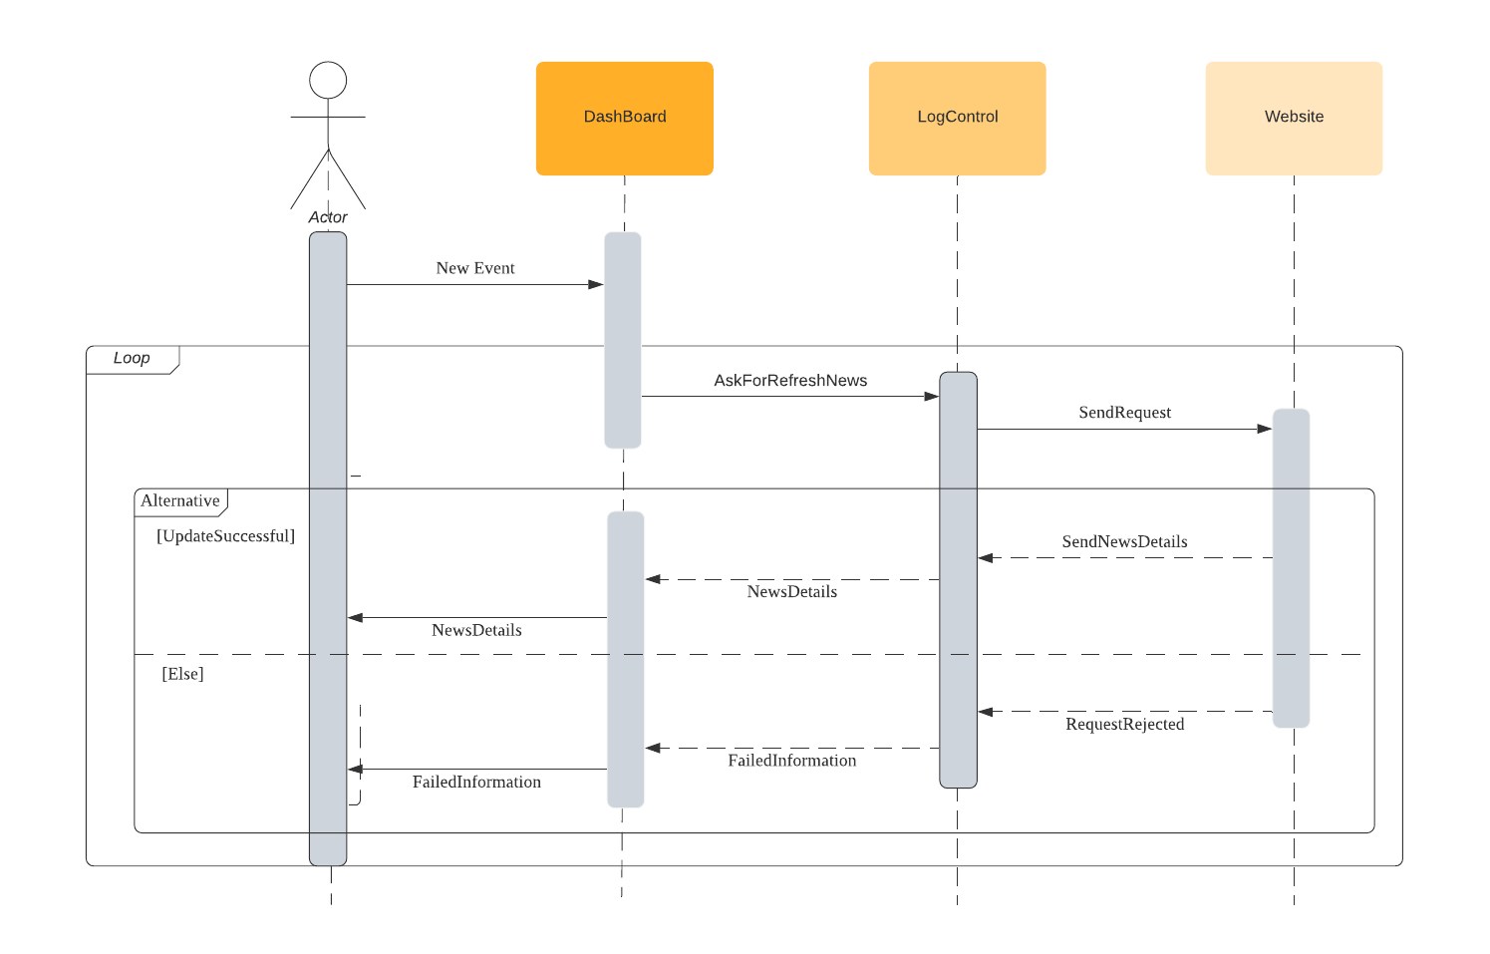
Sequence Diagram:
Daily CDC news

Slide 20
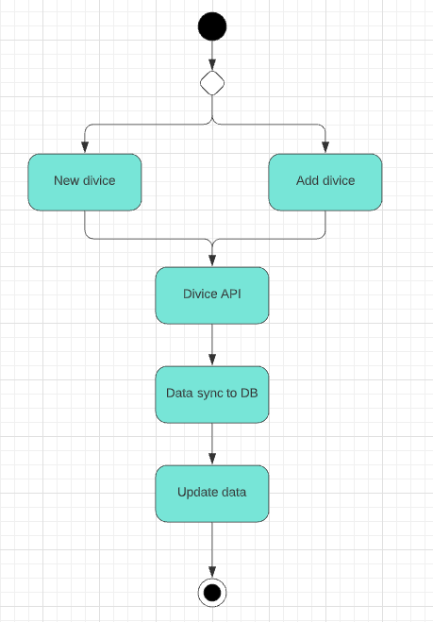
User Case: Wearable Devices
Sync with wearable devices:
Steps per day
Hearts beats alert
Blood oxygen level monitor
Works with any devices with required API
User can add new devices later

Slide 21
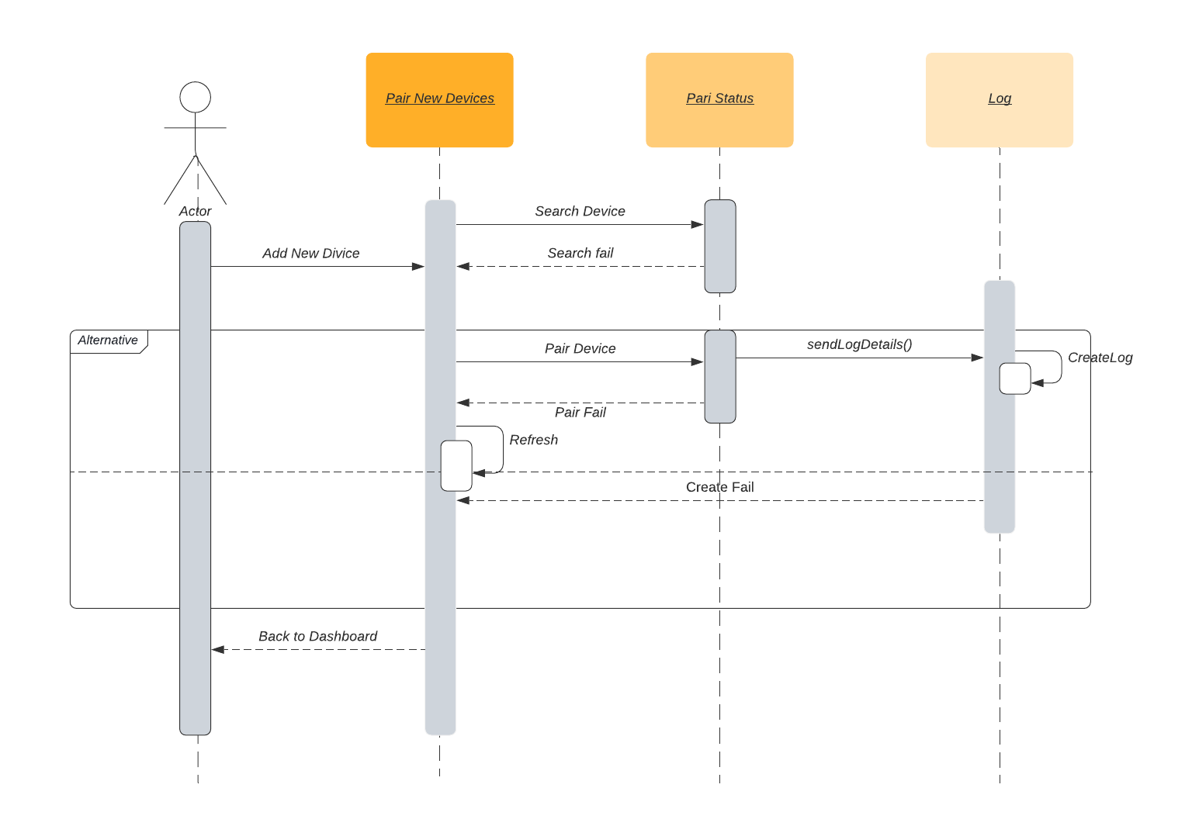
Sequence Diagram:
Add Wearable Devices

Slide 22
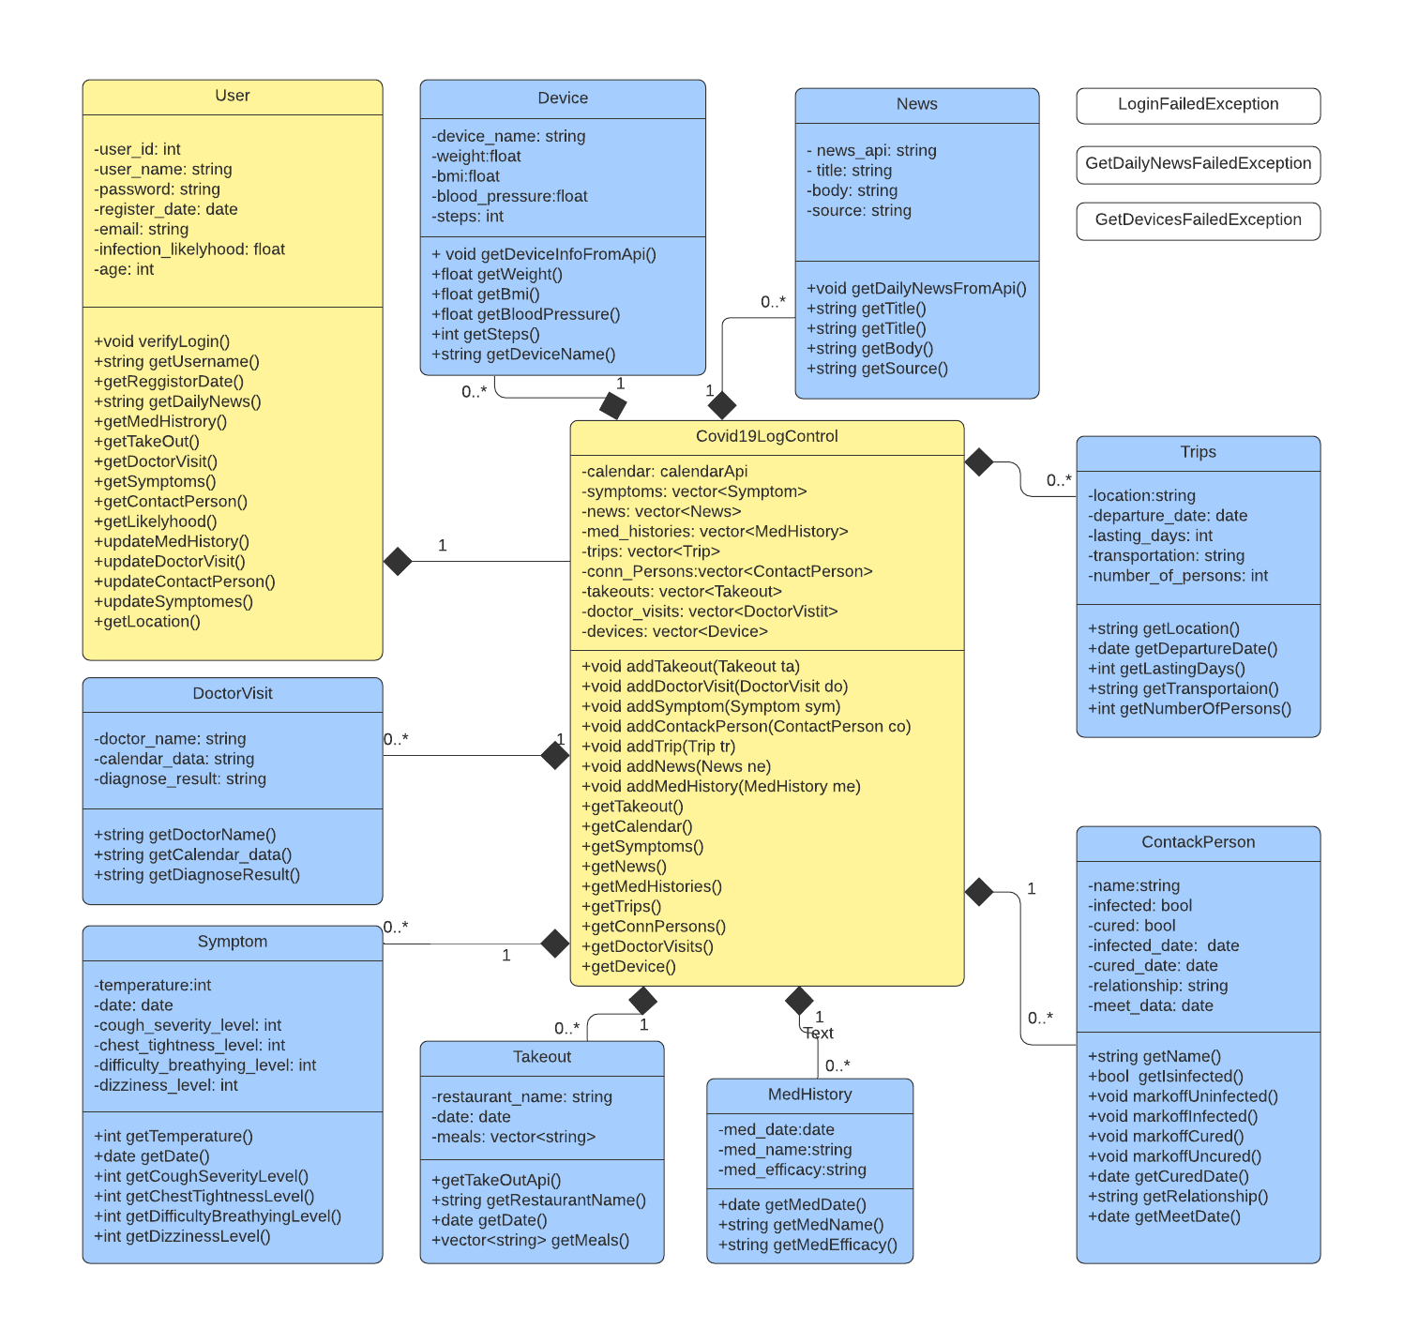
Class Diagram:

Slide 23
OCL - Business Rules
context CreateAccount inv:
self.Name.length >= 6 and self.Name.length <= 18
self.Password.length >=6 and self.Password.length <= 18
context Risk inv:
self.likelyhood > 0 and self.likelyhood <1
context Symptom inv:
self.symptom <> null
context Dashboard inv:
showLog.length = 8

Slide 24
OCL Authentication
Authenticate(): Boolean
Context Authentication:: authenticate(info:Info)
pre: info<> null
post: result = true or false

Slide 25
OCL Takeout
Create(): Boolean
Context Takeout:: create(String:restaurant_name, Date: date, vector<string>: meals)
pre: restaurant_name<> null and meals <> null
post: self.findLog(id) = true

Slide 26
OCL Takeout
Show(): ArrayList<Log>
Context Takeout:: show()
pre: self.userid<> null
post: ShowLogDashboard::Loglist<> null

Slide 27
OCL Takeout
Delete(): Boolean
Context ShowLogDashboard:: delete(string: LogId)
pre: Takeout::findLog(LogId) = true
post: Takeout::findLog(LogId) = false

Slide 28
OCL ShowLogDashboard
Refresh(): null
Context ShowLogDashboard:: refresh()
pre: self.UserId <> null
post: self.getTime() - self.lastLoadTime < 5000

